Slide 1
Module3 Unit2
Point to the door.

Slide 2

stand up 起立

Slide 3

sit down 坐下

Slide 4

point to
指向

Slide 5

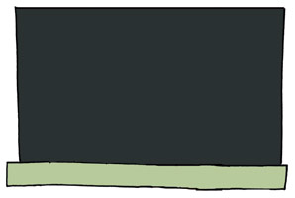

Point to the door.
Point to the blackboard.
Point to the window.

Slide 6
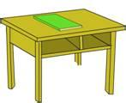
PPT模板：www.1ppt.com/moban/ PPT素材：www.1ppt.com/sucai/
PPT背景：www.1ppt.com/beijing/ PPT图表：www.1ppt.com/tubiao/
PPT下载：www.1ppt.com/xiazai/ PPT教程： www.1ppt.com/powerpoint/
资料下载：www.1ppt.com/ziliao/ 范文下载：www.1ppt.com/fanwen/
试卷下载：www.1ppt.com/shiti/ 教案下载：www.1ppt.com/jiaoan/
PPT论坛：www.1ppt.cn PPT课件：www.1ppt.com/kejian/
语文课件：www.1ppt.com/kejian/yuwen/ 数学课件：www.1ppt.com/kejian/shuxue/
英语课件：www.1ppt.com/kejian/yingyu/ 美术课件：www.1ppt.com/kejian/meishu/
科学课件：www.1ppt.com/kejian/kexue/ 物理课件：www.1ppt.com/kejian/wuli/
化学课件：www.1ppt.com/kejian/huaxue/ 生物课件：www.1ppt.com/kejian/shengwu/
地理课件：www.1ppt.com/kejian/dili/ 历史课件：www.1ppt.com/kejian/lishi/
desk
Point to the .
Notes:
PPT模板：www.1ppt.com/moban/ PPT素材：www.1ppt.com/sucai/
PPT背景：www.1ppt.com/beijing/ PPT图表：www.1ppt.com/tubiao/
PPT下载：www.1ppt.com/xiazai/ PPT教程： www.1ppt.com/powerpoint/
资料下载：www.1ppt.com/ziliao/ 范文下载：www.1ppt.com/fanwen/
试卷下载：www.1ppt.com/shiti/ 教案下载：www.1ppt.com/jiaoan/
PPT论坛：www.1ppt.cn PPT课件：www.1ppt.com/kejian/
语文课件：www.1ppt.com/kejian/yuwen/ 数学课件：www.1ppt.com/kejian/shuxue/
英语课件：www.1ppt.com/kejian/yingyu/ 美术课件：www.1ppt.com/kejian/meishu/
科学课件：www.1ppt.com/kejian/kexue/ 物理课件：www.1ppt.com/kejian/wuli/
化学课件：www.1ppt.com/kejian/huaxue/ 生物课件：www.1ppt.com/kejian/shengwu/
地理课件：www.1ppt.com/kejian/dili/ 历史课件：www.1ppt.com/kejian/lishi/

Slide 7

chair
Point to the .

Slide 8
Desk, desk, point to the desk.
Chair, chair, point to the chair.
Door , door, point to the door.
Window , window, point to the window.
Blackboard, blackboard, point to the blackboard.
PPT模板：www.1ppt.com/moban/ PPT素材：www.1ppt.com/sucai/
PPT背景：www.1ppt.com/beijing/ PPT图表：www.1ppt.com/tubiao/
PPT下载：www.1ppt.com/xiazai/ PPT教程： www.1ppt.com/powerpoint/
资料下载：www.1ppt.com/ziliao/ 范文下载：www.1ppt.com/fanwen/
试卷下载：www.1ppt.com/shiti/ 教案下载：www.1ppt.com/jiaoan/
PPT论坛：www.1ppt.cn PPT课件：www.1ppt.com/kejian/
语文课件：www.1ppt.com/kejian/yuwen/ 数学课件：www.1ppt.com/kejian/shuxue/
英语课件：www.1ppt.com/kejian/yingyu/ 美术课件：www.1ppt.com/kejian/meishu/
科学课件：www.1ppt.com/kejian/kexue/ 物理课件：www.1ppt.com/kejian/wuli/
化学课件：www.1ppt.com/kejian/huaxue/ 生物课件：www.1ppt.com/kejian/shengwu/
地理课件：www.1ppt.com/kejian/dili/ 历史课件：www.1ppt.com/kejian/lishi/

Slide 9
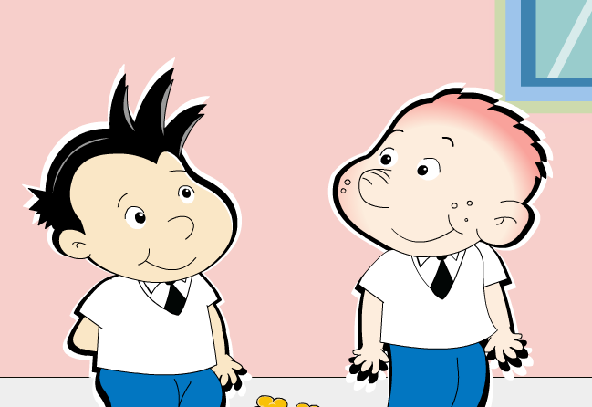
?

Slide 10


?

Slide 11
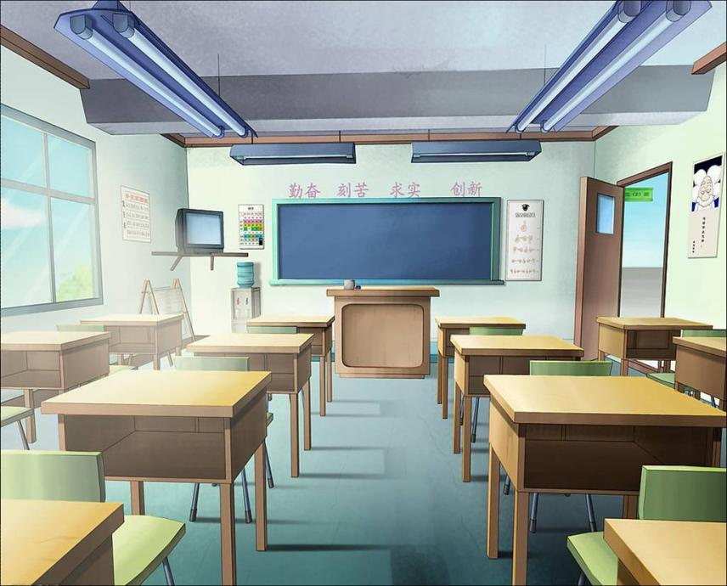


Slide 12

Chant
Door, door ,point to the door.
Window, window, point to the window.
Blackboard, blackboard, point to the blackboard.

Slide 13

bird

Slide 14
Let’s play a Guessing game
亲爱的同学们，让我们来玩个猜单词的游戏，看看谁最棒。请猜我们本节课所学的单词和短语。

Slide 15
door

Slide 16
blackboard

Slide 17

window

Slide 18

point to

Slide 19

stand up

Slide 20

Point to the window.

Slide 21

sit down

Slide 22
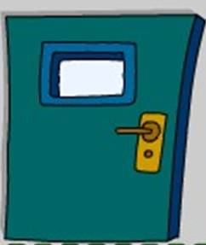
Point to the door.

Slide 23
window

Slide 24
door

Slide 25
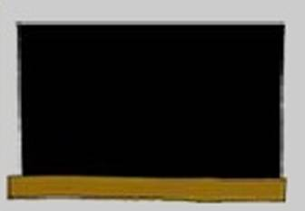
blackboard

Slide 26

bird

Slide 27
Point to the blackboard

Slide 28

Sing a song
Please stand up. Please sit down.
Point to the window. Point to the door.
Please stand up. Please sit down.
Point to the blackboard and Point to the door

Slide 29
Homework
Sing the song and read the text to your parents and friends （把今天所学习歌曲和课文唱和读给你父母和朋友听。）

Slide 30

Thank you!

